Slide 1



Consumer Empowerment and Energy Poverty Mitigation
Elena Markova-Velinova, MSc. Electrical Engineer, Commissioner
Energy, Water Services and Municipal Waste Management Services
Regulatory Commission of the Republic of North Macedonia (ERC)
Tbilisi 23 September 2026

Slide 2
Electricity Tariffs for Households and Small Consumers
ERC Measures for Households and Small Consumers
Time-of-Use Electricity Tariffs
ERC applies differentiated electricity tariffs to encourage efficient energy consumption.
High Tariff
Price depends on the amount of electricity consumed.
Block tariff system promotes responsible energy use.
Low Tariff
Fixed price regardless of consumption.
Current price: 2.1893 MKD/kWh; Approximately 50% lower than the high tariff.
Low Tariff Periods
Daily: 13:00–15:00; Night: 22:00–07:00; All day Sunday
High Tariff Periods
All remaining hours during the week.

Slide 3
Block Tariffs in High Tariff Period for Household Electricity Consumption
The block tariff system encourages energy efficiency by applying different prices according to electricity consumption.
Key Objective: Encourage rational electricity consumption while protecting households with lower energy needs.
Block | Consumption | Price
Block 1 (69 %) | 0–210 kWh | 4.7074 MKD/kWh
Block 2 (25 %) | 211–630 kWh | 5.8976 MKD/kWh
Block 3 (3 %) | 631–1050 kWh | 7.8537 MKD/kWh
Block 4 (3 %) | Above 1050 kWh | 19.1904 MKD/kWh

Slide 4
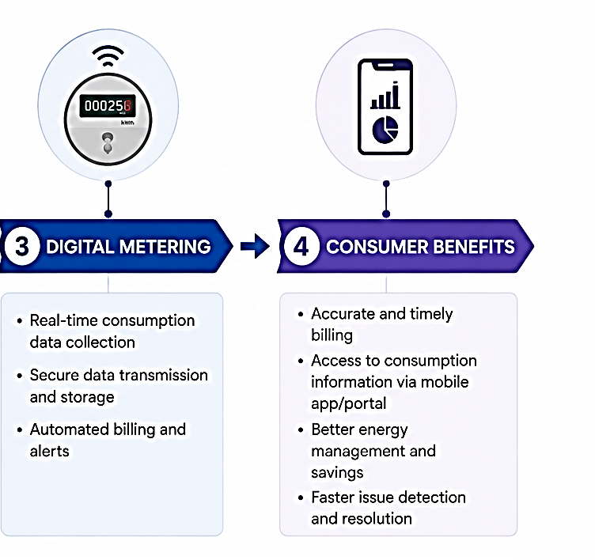
Smart Metering
1. Smart Metering Program
ERC supports the gradual implementation of smart electricity meters for households and small consumers.
2. Main Activities
Installation of smart electricity meters.
Ten-year rollout plan prepared by the Distribution System Operator (DSO) and approved by ERC (100.000 meters to be changed every year).
Digital metering improves billing accuracy and transparency.
Better consumption monitoring enables consumers to manage energy use more efficiently.

Slide 5
Government Measures
Government Measures to Protect Vulnerable Consumers
Program for Protection of Vulnerable Customers (2026)
The Government provides targeted support to vulnerable households in accordance with the Law on Social Protection. The Ministry of Energy, the Ministry of Social Policy and ERC are responsible for implementing this program.
Methodology for Measuring Energy Poverty
Developed by the Ministry of Energy in cooperation with the Ministry for Social Policy and calculated by State statistical Office.
Support Measures:
Financial assistance: Support for paying household energy bills.
Energy efficiency support: Financial assistance for purchasing inverter air-conditioning systems for heating and cooling (approx. 450 Euro per household).
Objective: Reduce energy poverty while improving household energy efficiency.

Slide 6
Key Takeaways
ERC contributes to consumer empowerment by:
✔ Applying fair and transparent electricity tariffs.
✔ Promoting efficient electricity consumption through block tariffs.
✔ Supporting smart metering and digitalization.
✔ Protecting vulnerable consumers.
✔ Cooperating with Government institutions to reduce energy poverty.

Slide 7


Thank You!
Elena Markova Velinova, MSc, Electrical Engineer
Commissioner, ERC
✉ elena.markova@erc.org.mk
🌐 www.erc.org.mk
Questions?

